Slide 1
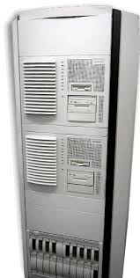
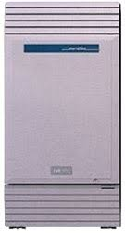

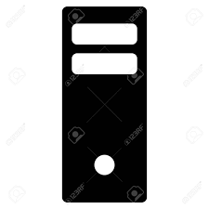


CUBM – Bed Management Interface Call Flow
EVSTech
Dials number for CUBM on bedside phone
PBX
Routes call to router running cubm script
CUBM
Walks EVSTech through entering ID and bed status.
Forwards that info to Cloverleaf via TCP socket.
Cloverleaf
Receives data from CUBM, formats as HL7 and forwards to Meditech Bed Management
EMR
Bed Management updates software and Bed Boards with current bed status

